Slide 1
Artem Aliev
Bring Your Own Spark
with Enterprise Security

Slide 2
1 | DSE BYOS Overview
2 | BYOS Configuration Tools
3 | Use Cases
4 | BYOS vs OSS Spark Connector
5 | Kerberos Demo

Slide 3
Connect Your Spark to DSE
Spark
DSE Spark
SQL
SQL
Cluster Manger
CFS
Hive
Meta
Store
HiveMeta
Store
HDFS
DSE C*

Slide 4
Connect Your Spark to DSE
Spark
DSE Spark
SQL
SQL
Cluster Manger
CFS
Hive
Meta
Store
HiveMeta
Store
HDFS
DSE C*

Slide 5
Bring Your Own Spark!
A simple way to
Read Cassandra and CFS data from external Spark
Export necessary configuration info to connect to DSE
Includes security options
Export necessary Jars to connect
Attach these exported resource to a spark-submit
Also
Simple way to get the SparkSQL syntax to create catalog entries for tables in Cassandra
Read external HDFS data from DSE Spark jobs

Slide 6
BYOS Components
BYOS assembly jar (add it to spark jars)
spark-cassanda-connector, secure transport, CFS and dependencies
$DSE_HOME/clients/dse-byos_2.10-5.0.2-SNAPSHOT.jar
Spark configuration generator (merge result with spark-defaults.conf)
Contains Cassandra host, auth type and factories
dse client-tool configuration byos-export byos.conf
Spark-SQL Schema mapping generator (run result by spark-sql)
The sql script will create databases and table mapping for all C* tables
$DSE_HOME/clients/dse-byos_2.10-5.0.2.jar
dse client-tool configuration byos-export byos.conf
dse client-tool spark sql-schema -all > mapping.sql

Slide 7
byos.conf
#Exported node configuration properties
#Fri Jul 29 22:55:48 UTC 2016
spark.hadoop.cassandra.host=127.0.0.1
spark.hadoop.cassandra.auth.kerberos.enabled=false
spark.cassandra.auth.conf.factory=com.datastax.bdp.spark.DseByosAuthConfFactory
spark.cassandra.connection.port=9042
spark.hadoop.cassandra.ssl.enabled=false
spark.hadoop.cassandra.auth.kerberos.defaultScheme=false
spark.hadoop.cassandra.client.transport.factory=com.datastax.bdp.transport.client.TDseClientTransportFactory
spark.cassandra.connection.host=127.0.0.1
spark.hadoop.fs.cfs.impl=com.datastax.bdp.hadoop.cfs.CassandraFileSystem
spark.hadoop.cassandra.connection.native.port=9042
spark.hadoop.dse.client.configuration.impl=com.datastax.bdp.transport.client.HadoopBasedClientConfiguration
spark.cassandra.connection.factory=com.datastax.bdp.spark.DseCassandraConnectionFactory
spark.hadoop.cassandra.config.loader=com.datastax.bdp.config.DseConfigurationLoader
spark.hadoop.cassandra.connection.rpc.port=9160
spark.hadoop.dse.system_memory_in_mb=7985
spark.hadoop.cassandra.thrift.framedTransportSize=15728640
spark.hadoop.cassandra.partitioner=org.apache.cassandra.dht.Murmur3Partitioner
spark.hadoop.cassandra.dsefs.port=5598

Slide 8
mapping.sql
CREATE DATABASE IF NOT EXISTS test_keyspace;
USE test_keyspace;
CREATE TABLE test_table
USING org.apache.spark.sql.cassandra
OPTIONS (
keyspace "test_keyspace",
table "test_table",
pushdown "true");

Slide 9
Add BYOS to the Spark
Copy dse-byos.jar, byos.conf and mapping.sql to a spark client node
Merge byos.conf properties with spark defaults
add DSE tables mapping (optional)
Run any spark application the same way:
cat byos.conf /etc/spark/conf/spark-defaults.conf > merged.conf
spark-sql --jars dse-byos*.jar --properties-file merged.conf –f mapping.sql
spark-shell --jars dse-byos*.jar --properties-file merged.conf

Slide 10
SSL Support
Copy DSE client SSL certificate truststore and keystore files to Spark nodes
Pass file locations to configuration generator
Tip: You can use --files spark parameter to distribute files for the YARN job
dse client-tool configuration byos-export \
--set-truststore-path .truststore --set-truststore-password password \
--set-keystore-path .keystore --set-keystore-password password \
byos.conf
spark-shell --jars dse-byos*.jar --properties-file merged.conf \
--files .truststore,.keystore

Slide 11
Kerberos
Kerberos setup on Spark cluster:
Just specify preferred JAAS connect in .java.login.config
DseClient {
com.sun.security.auth.module.Krb5LoginModule required
useTicketCache=true
renewTGT=true;
};
No Kerberos on Spark Cluster? (less secure)
Request DSE token manually while generate config
Driver
DSE Token
Executors
Kerberos Auth
DSE Token
Auth with DSE Token
dse client-tool configuration byos-export --generate-token byos.conf

Slide 12

Usage: Migrate/Save/Load Data
DSE tables to Hadoop and back
Streaming
DSE Max CFS and HDFS
spark-shell
dse spark
scala> val df = sqlContext.read.format("org.apache.spark.sql.cassandra")
.options(Map("keyspace"->"t", "table" -> "t")).load()
df.write.format("json").save ("/tmp/t.json”)
session_stream.saveToCassandra("web", "sessions")
scala> sc.textFile("cfs:/data").saveAsTextFile("hdfs://hadoop1/data")
scala> sc.textFile("hdfs://hadoop1/data").saveAsTextFile("cfs:/data")

Slide 13
Usage: JOIN/Enrich with C* Tables
all C* tables are available after mapping
join your RDD with C*
KILLER FEATURE: Enrich your stream, with C* on the fly
spark-sql> select * from hive_table h join cassandra_table с on h.key = c.key
scala> hrdd.joinWithCassandraTable("t", "t")
click_stream.joinWithCassandraTable("web", "sessions")

Slide 14
Building Full Lambda Architecture?

Slide 15

Add Speed Layer!
DSE
DSE

Slide 16
HBase?

Slide 17
Still HBase?
Master-less architecture
Double Master/Slave architecture
One for server, one for storage

Slide 18
OSS Spark Connector or DSE BYOS?
Feature | OSS | DSE BYOS
DataStax Official Support | NO | YES
Spark SQL Source Tables / Cassandra DataFrames | YES | YES
CassandraRDD batch and streaming | YES | YES
C* to Spark-SQL table mapping generator | NO | YES
Spark Configuration Generator | NO | YES
Cassandra File System Access | NO | YES
SSL Encryption | YES | YES
User/password authentication | YES | YES
Kerberos authentication | NO | YES

Slide 19
Kerberos Demo

Slide 20
Kerberos Demo
No time for live demo. Find me at Meet Expert, for it

Slide 21
Kerberos Demo
MIT Kerberos usage is well documented.
Notes:
It is not a Way of the Samurai

Slide 22
Kerberos Demo
MIT Kerberos usage is well documented.
Notes:
It is not a Way of the Samurai

Slide 23
Kerberos Demo
MIT Kerberos usage is well documented.
MS Domain Controller will be used

Slide 24
Kerberos Demo
MIT Kerberos usage is well documented.
MS Domain Controller will be used
Cloudera and MapR use MIT Kerberos

Slide 25
Kerberos Demo
MIT Kerberos usage is well documented.
MS Domain Controller will be used
Cloudera and MapR use MIT Kerberos
Notes:
It is not a Way of the Samurai

Slide 26
Kerberos Demo
MIT Kerberos usage is well documented.
MS Domain Controller will be used
Cloudera and MapR use MIT Kerberos
Hortonworks supports Active Directory

Slide 27
Kerberos Demo
MIT Kerberos usage is well documented.
MS Domain Controller will be used
Cloudera and MapR use MIT Kerberos
Hortonworks supports Active Directory
DataStax Enterprise full support:
Kerberos Auth
LDAP Auth
LDAP Roles
Notes:
That’s the way!

Slide 28
Demo Servers
Domain Controller: Kerberos, Secure LDAP, DNS
Realm: DC.DATASTAX.COM
DNS Domain: dc.datastax.com
Windows2012R2 server
2 Hadoop nodes
2 DataStax Enterprise 5.0 nodes
Ubuntu 14.04
h1
h2
c1
c2
Byos 5.0.2
Spark 1.6.1
Hadoop 2.7
DSE 5.0.2
Ubuntu LTS 14.04
Ubuntu LTS 14.04

Slide 29
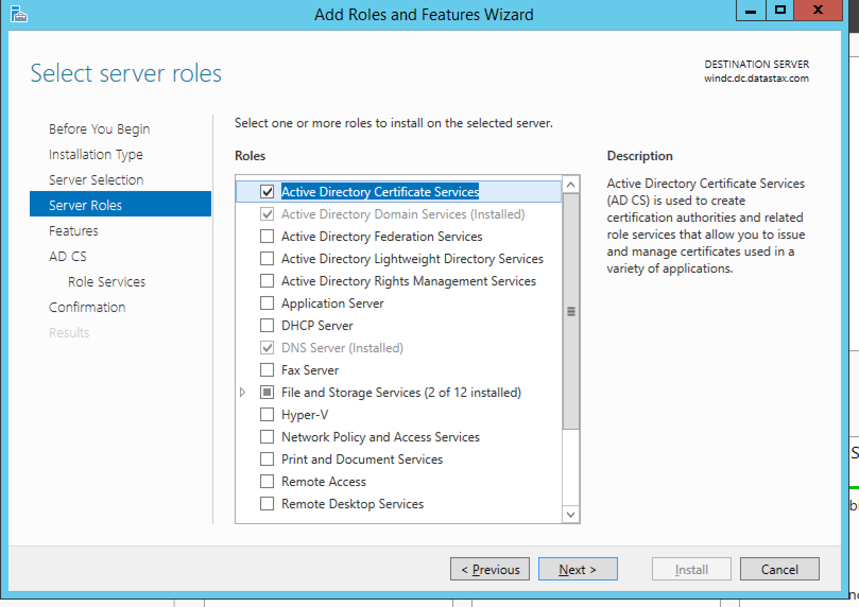
Domain Controller Setup
DNS forward and reverse zones
Secure LDAP
Ambari setup wizard
LDAP DseRoleManager (Optional)
Organization Units
for Hadoop and DSE users/principals

Slide 30
Linux Join the Domain (Optional)
REALMD and SSSD
#> apt-get install realmd sssd samba-common samba-common-bin samba-libs sssd-tools krb5user adcli packagekit vim ntp -y
#> realm --verbose join -U Administrator DC.DATASTAX.COM
# optional create home directories for domain users
#> echo 'session required pam_mkhomedir.so skel=/etc/skel/ umask=0022' >> /etc/pam.d/common-session
Various workaround/additional steps for you Linux will be required
#> ln -s /usr/lib/x86_64-linux-gnu/ldb /usr/lib/x86_64-linux-gnu/samba
Security will need to be tuned
#> apt-get install realmd sssd samba-common samba-common-bin samba-libs \ sssd-tools krb5-user adcli packagekit vim ntp -y
#> realm --verbose join -U Administrator DC.DATASTAX.COM
# optional create home directories for domain users
#> echo 'session required pam_mkhomedir.so skel=/etc/skel/ umask=0022' >> \ /etc/pam.d/common-session
#> ln -s /usr/lib/x86_64-linux-gnu/ldb /usr/lib/x86_64-linux-gnu/samba

Slide 31
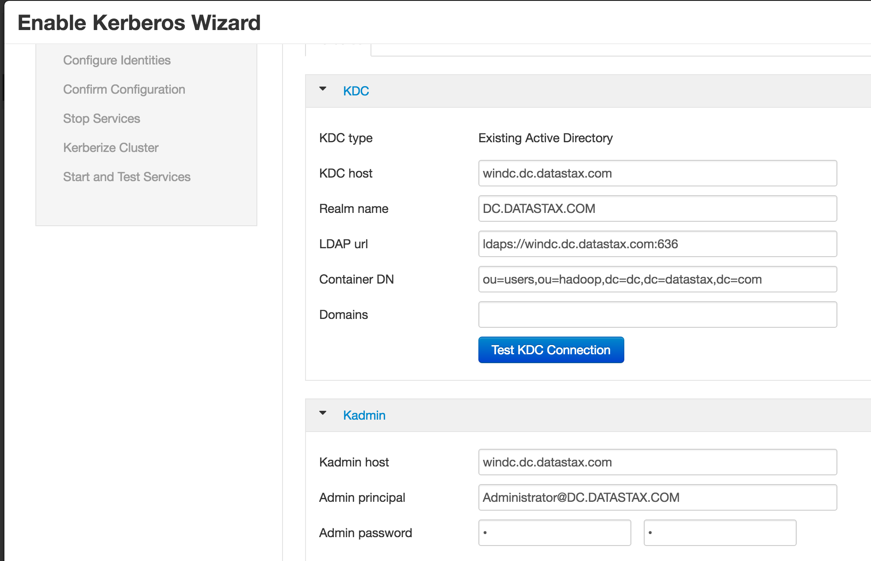
Ambari Kerberos Wizard
Admin->Kerberos -> ActiveDirectory
DC data :
next next next
That will create a bunch of Windows users and keytabs for them
Configure Hadoop component security and permissions

Slide 32
DataStax Enterprise
On windows:
Create ‘dse’ user in a GUI.
Create DSE keytabs for each node:
c:\>ktpass -princ HTTP/c1.dc.datastax.com@DC.DATASTAX.COM -mapUser dse -pass password -crypto all -out tmp.keytab
c:\>ktpass -princ dse/c1.dc.datastax.com@DC.DATASTAX.COM -mapUser dse -pass password -crypto all –in tmp.keytab -out c1.keytab
copy keytabs to appropriate node
Enable Kerberos on DSE nodes:
https://docs.datastax.com/en/datastax_enterprise/5.0/datastax_enterprise/unifiedAuth/configAuthenticate.html
c:\>ktpass -princ HTTP/c1.dc.datastax.com@DC.DATASTAX.COM -mapUser dse -pass ****** -crypto all -out tmp.keytab
c:\>ktpass -princ dse/c1.dc.datastax.com@DC.DATASTAX.COM -mapUser dse -pass ****** -crypto all –in tmp.keytab -out c1.keytab

Slide 33
DataStax Enterprise
dse.yaml
authenticator: com.datastax.bdp.cassandra.auth.DseAuthenticator
authorizer: com.datastax.bdp.cassandra.auth.DseAuthorizer
authentication_options:
enabled: true
kerberos_options:
Replace default cassandra user:
cqlsh> create role 'cassandra@DC.DATASTAX.COM' with SUPERUSER = true AND LOGIN = true;
User for Hadoop Spark Thrift Server
cqlsh> create role 'hive/hdp0.dc.datastax.com@DC.DATASTAX.COM' with LOGIN = true;
cqlsh> create role 'cassandra@DC.DATASTAX.COM' with SUPERUSER = true AND LOGIN = true;
cqlsh> create role 'hive/hdp0.dc.datastax.com@DC.DATASTAX.COM' with LOGIN = true;

Slide 34
BYOS
Generate the byos.conf usual way
dse client-tool configuration byos-export byos.conf
create .java.login.config in Hadoop user home directory:
DseClient {
com.sun.security.auth.module.Krb5LoginModule required
useTicketCache=true
renewTGT=true;
};
keytab usage could be configured in the file
dse client-tool configuration byos-export byos.conf

Slide 35
Spark
#>kinit
Password for cassandra@DC.DATASTAX.COM:
Add CFS to spark.yarn.access.namenodes property, to request C* token.
#> spark-shell --master yarn-client --jars dse-byos*.jar --properties-file merged.conf --conf spark.yarn.access.namenodes=cfs://node1/

Slide 36
Spark Thrift Server
Start:
Connect:
#> kinit -kt /etc/security/keytabs/hive.service.keytab \ hive/hdp0.dc.datastax.com@DC.DATASTAX.COM
#> cat /etc/spark/conf/spark-thrift-sparkconf.conf byos.conf > byos-thrift.conf
#> start-thriftserver.sh --properties-file byos-thrift.conf --jars dse-byos*.jar
#> kinit
#> beeline -u \ 'jdbc:hive2://hdp0:10015/default;principal=hive/_HOST@DC.DATASTAX.COM'

Slide 37
Bring Your Own Spark!
Spark
DSE Spark
SQL
SQL
Cluster Manger (yarn)
CFS
Hive
Meta
Store
HiveMeta
Store
HDFS
Cassandra

